Slide 1


0
10
9
8
7
6
5
4
3
2
1

Slide 2

Robotics Corner

Slide 3
Robotics Corner
Linux
Linux is an open Source operating system that is widely used in most of the companies.

Slide 4
01
System Information
02
Managing Services
AGENDA
03
Package management
04
Basic shell scripting concepts

Slide 5



Linux
System Management and Basic Scripting
01285960031
01285960031
www.roboticscorner.tech

Slide 6
System information commands
01
System Information
To know only the system name, you can use the uname command without any switch that will print system information or the uname -s command will print the kernel name of your system.
To view your Linux network hostname, use the ‘-n’ switch with the uname command as shown.
To get information about the Linux kernel version: uname -v
To get the information about your Linux kernel release: uname -r
To print your Linux hardware architecture name: uname -m
All this information can be printed at once by running the ‘uname -a’ command
01285960031
01285960031
www.roboticscorner.tech

Slide 7
Df/du
01
System Information
The "disk free" (df) command tells you the total disk size, space used, space available, usage percentage, and what partition the disk is mounted on.
The "disk usage" (du) is used you need to see the size of a given directory or subdirectory. It runs at the object level and only reports on the specified stats at the time of execution.
01285960031
01285960031
www.roboticscorner.tech

Slide 8
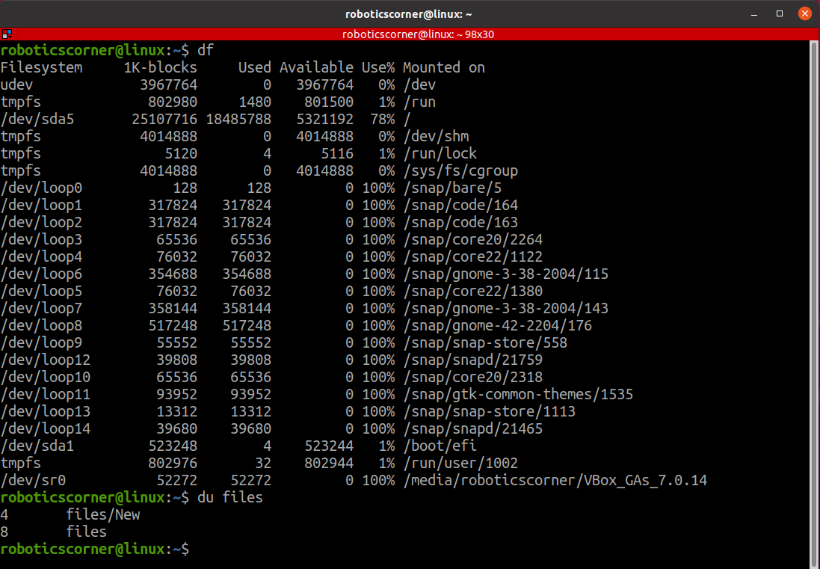
01
System Information
01285960031
01285960031
www.roboticscorner.tech

Slide 9
Managing services and daemons
02
Managing Services
An operating system requires programs that run in the background called services. In a Linux system, these services are called daemons. They are managed using an init system like systemd.
In Unix-based computer operating systems, init (short for initialization) is the first process started during booting of the operating system. Init is a daemon process that continues running until the system is shut down.
01285960031
01285960031
www.roboticscorner.tech

Slide 10
Process vs service
02
Managing Services
A process is an instance of a running program. When you execute a program, it becomes a process.
Processes are the basic units of execution in a Linux system.
Each process has a unique process ID (PID) assigned to it.
Processes have their own memory space, file descriptors, and other resources.
01285960031
01285960031
www.roboticscorner.tech

Slide 11
Process vs service
02
Managing Services
A service is a background process or daemon that runs on a system to provide specific functionality or perform specific tasks.
Services often start when the system boots up and continue running in the background, waiting for specific events or requests.
Services are usually managed by an init system like systemd, which can start, stop, restart, and manage their lifecycle, there are others, but system is the most used.
01285960031
01285960031
www.roboticscorner.tech

Slide 12
Managing services and daemons
02
Managing Services
Most modern Linux systems use systemd – an init system and service manager for controlling daemons. It is a drop-in replacement for older distributions’ init processes: pstree → started by systemd
Systemd has the systemctl command, which lets users manage their system and service configurations. For example, use it to list all unit files in your Linux server: daemons = units = services
sudo systemctl list-unit-files --type service --all
01285960031
01285960031
www.roboticscorner.tech

Slide 13
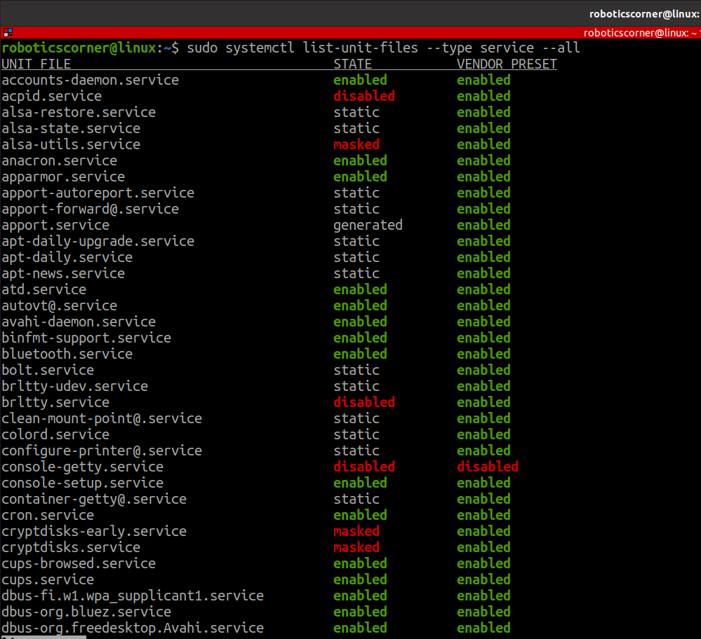
02
Managing Services
01285960031
01285960031
www.roboticscorner.tech

Slide 14
sudo systemctl list-unit-files --type service --all
02
Managing Services
Enabled – active services running in the background.
Disabled – disabled services that users can enable directly using the start command.
Masked – stopped services that can only be started by removing the masked property.
Static – services that only run when another program or unit requires them.
Failed – inactive services that can’t load or operate properly.
01285960031
01285960031
www.roboticscorner.tech

Slide 15
Managing services and daemons
02
Managing Services
To stop a service: sudo systmctl stop [SERVICE]
To get the status of a service: sudo systmctl status [SERVICE]
To start a service: sudo systmctl start [SERVICE]
To restart a service: sudo systmctl restart [SERVICE]
01285960031
01285960031
www.roboticscorner.tech

Slide 16
03
Package Management
When it comes to package management on Linux systems, two popular tools are YUM and APT. YUM, short for Yellowdog Updater Modified, is commonly used in Red Hat-based distributions like CentOS and RHEL. On the other hand, APT, which stands for Advanced Packaging Tool, is widely used in Debian, Ubuntu, and their derivatives. Understanding the differences between these package managers can help you effectively manage software installations and updates on your Linux system.
01285960031
01285960031
www.roboticscorner.tech

Slide 17
YUM vs. APT: Managing Software Packages on Linux
03
Package Management
YUM and APT are package managers that simplify the installation, upgrade, and configuration of software packages on Linux systems. While they serve the same purpose, there are some notable differences between them.
01285960031
01285960031
www.roboticscorner.tech

Slide 18
APT
03
Package Management
APT uses .deb files as the package format and is primarily used in Debian, Ubuntu, and related distributions.
APT provides several commonly used commands, such as update, upgrade, install, remove, purge, list, and search.
APT organizes options into functional groups and stores them in the /etc/apt/apt.conf file, which is organized in a tree structure.
01285960031
01285960031
www.roboticscorner.tech

Slide 19
apt
03
Package Management
When you install an application using apt in Ubuntu, the package manager (apt) does not contain all the data for the application itself. Instead, apt relies on repositories, which are online databases of software packages maintained by Ubuntu and its community.
When you instruct apt to install a package, it searches the repositories configured on your system to find the package and its dependencies. If the package and its dependencies are found, apt downloads them from the repository over the internet and installs them on your system.
The repositories contain metadata about the packages, such as their names, versions, descriptions, dependencies, and download locations. apt uses this metadata to locate and install the requested packages.
So, while apt itself doesn't contain all the data for each application, it acts as a tool to efficiently manage the installation and removal of software packages from online repositories.
01285960031
01285960031
www.roboticscorner.tech

Slide 20
yum
03
Package Management
YUM uses .rpm files and is commonly used in Red Hat-based distributions like CentOS, RHEL, Fedora, and OpenSUSE.
YUM offers commands like install, remove, search, info, and update.
YUM allows options to be set with global and repository-specific effects, and the configuration is managed in the /etc/yum.conf file
01285960031
01285960031
www.roboticscorner.tech

Slide 21
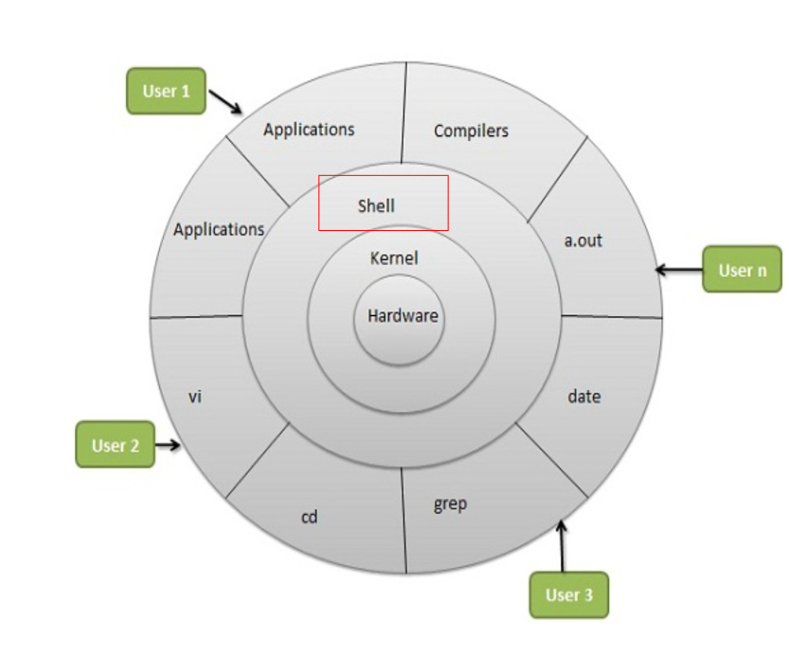
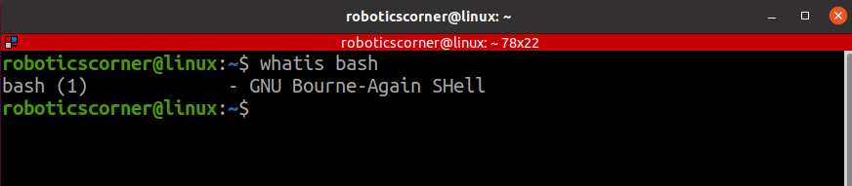
Basic shell scripting concepts
04
Basic shell scripting concepts
Shell is an interpreter for the applications/commands of a user to make the kernel manage the hardware.
It stands for Bourne-Again SHell
01285960031
01285960031
www.roboticscorner.tech

Slide 22
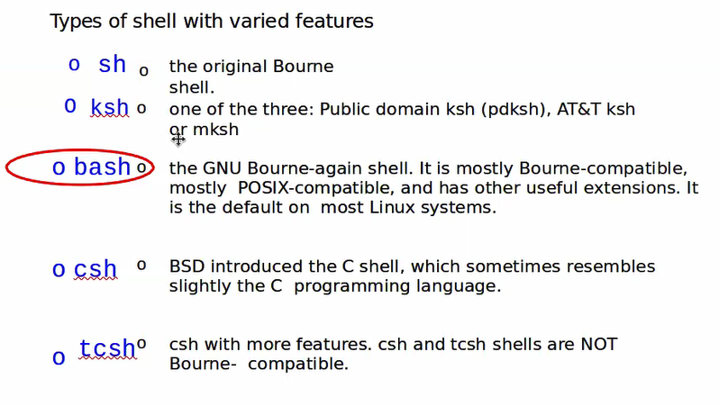
Types of shell
04
Basic shell scripting concepts
01285960031
01285960031
www.roboticscorner.tech

Slide 23
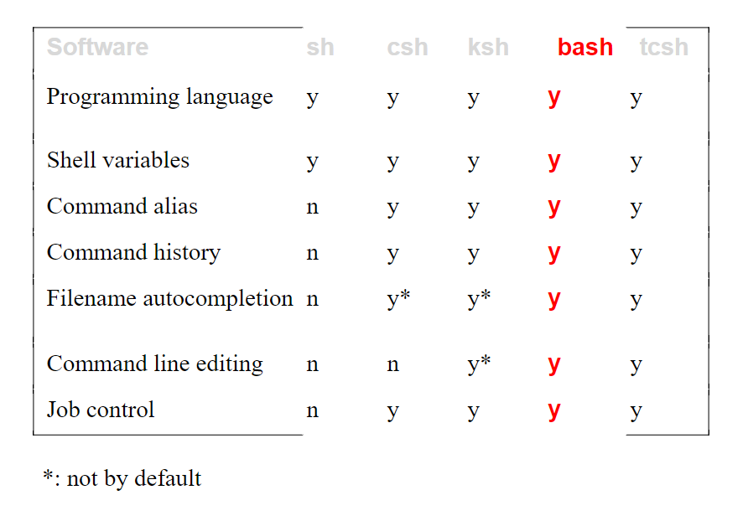
Shell comparison
04
Basic shell scripting concepts
Bash supports all because it was created by the linux foundation(non-profit organization) →time and resources are abundant
01285960031
01285960031
www.roboticscorner.tech

Slide 24
What can you do with a shell
04
Basic shell scripting concepts
File Management, Directory Management
Process Management, compile and run applications
Network Management
Shell Scripting
01285960031
01285960031
www.roboticscorner.tech

Slide 25
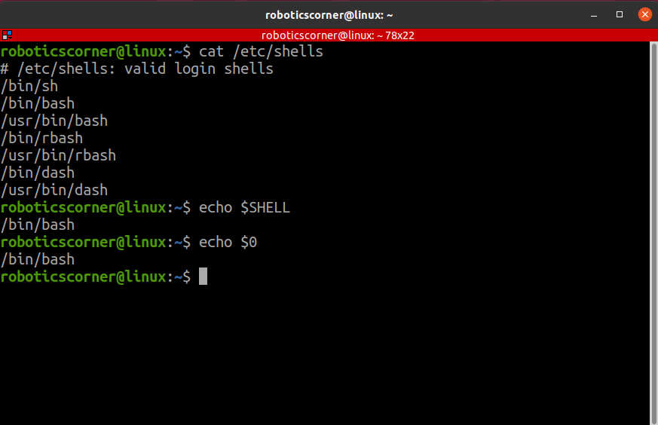
04
Basic shell scripting concepts
List available shells on the system: cat /etc/shells
To check the current shell you are using: echo $0 or echo $SHELL
01285960031
01285960031
www.roboticscorner.tech

Slide 26
Shell scripting
04
Basic shell scripting concepts
Script: a program written for a software environment to automate execution of tasks
A series of shell commands put together in a file
When the script is executed, those commands will be executed one line at a time automatically
Shell script is interpreted, not compiled.
01285960031
01285960031
www.roboticscorner.tech

Slide 27
When not to use shell scripting
04
Basic shell scripting concepts
Performance/Security-Critical Applications
Complex Data Structures and Algorithms
Cross-Platform Development
Large Software Projects
01285960031
01285960031
www.roboticscorner.tech

Slide 28
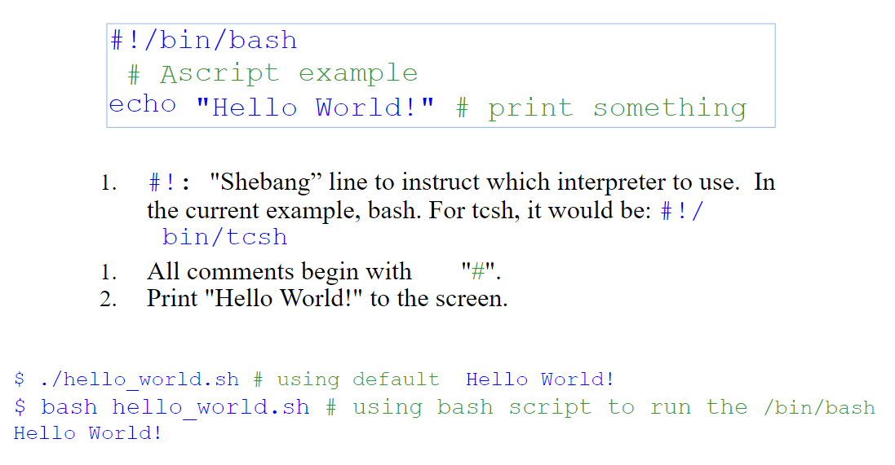
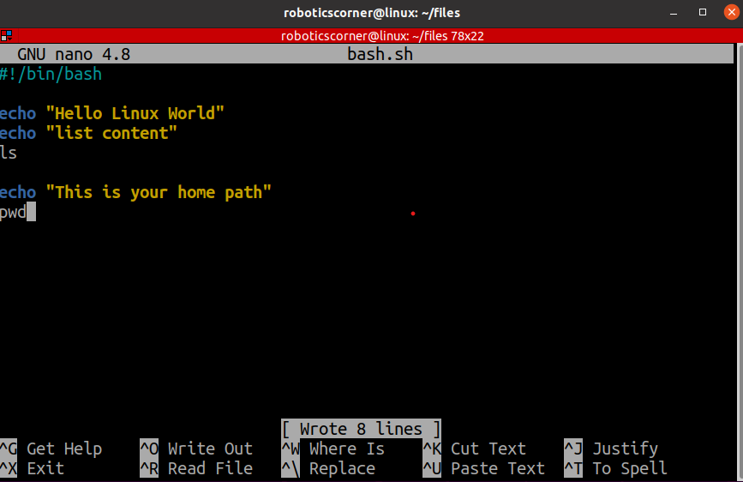
Hello
04
Basic shell scripting concepts
01285960031
01285960031
www.roboticscorner.tech

Slide 29
Hello
04
Basic shell scripting concepts
Do not forget the shebang line
01285960031
01285960031
www.roboticscorner.tech

Slide 30
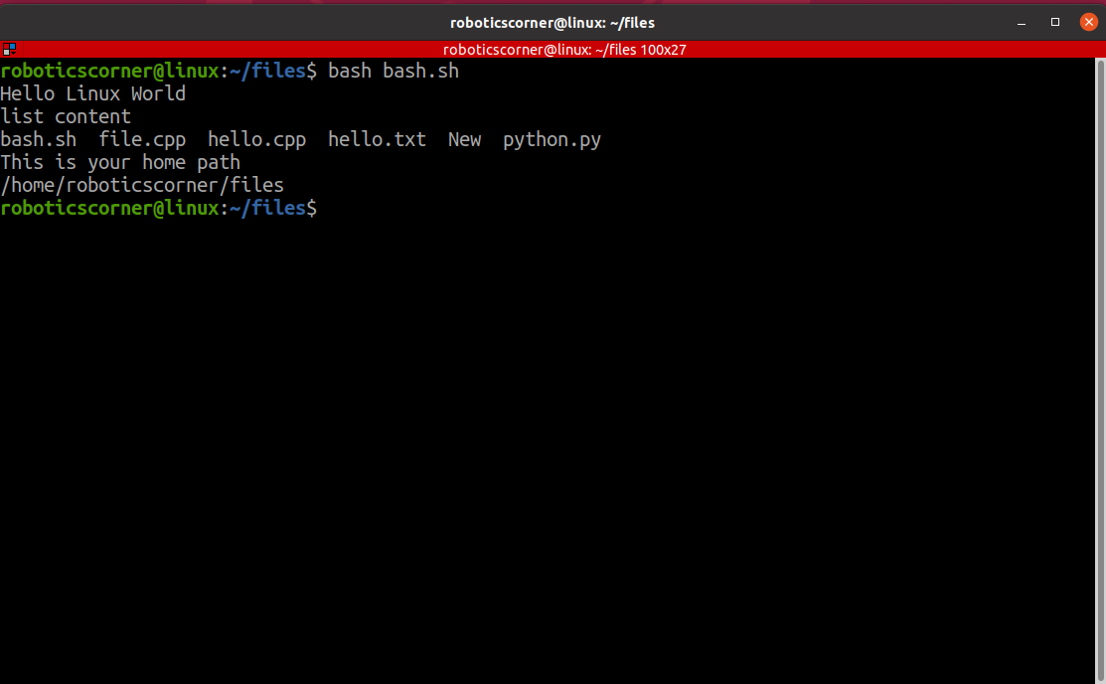
04
Basic shell scripting concepts
How to run the bash file
There is 2 ways
But! That’s not actually how we run it.
01285960031
01285960031
www.roboticscorner.tech

Slide 31
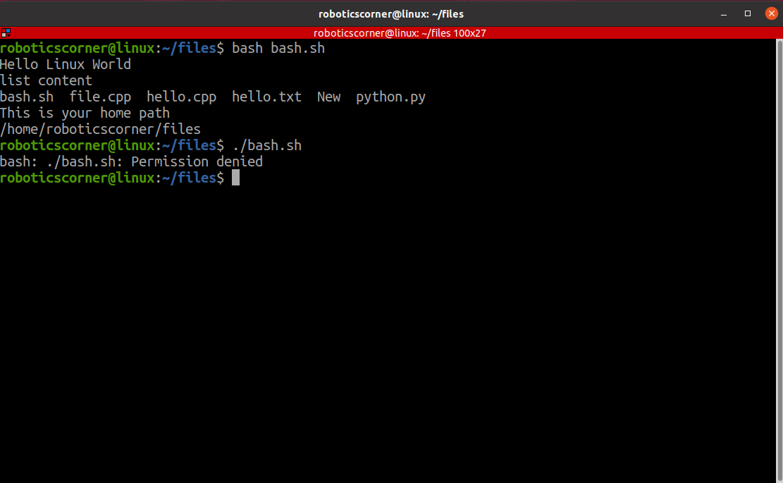
04
Basic shell scripting concepts
How to run the bash file
There is 2 ways
But! That’s not actually how we run it.
We have to make it executable
01285960031
01285960031
www.roboticscorner.tech

Slide 32
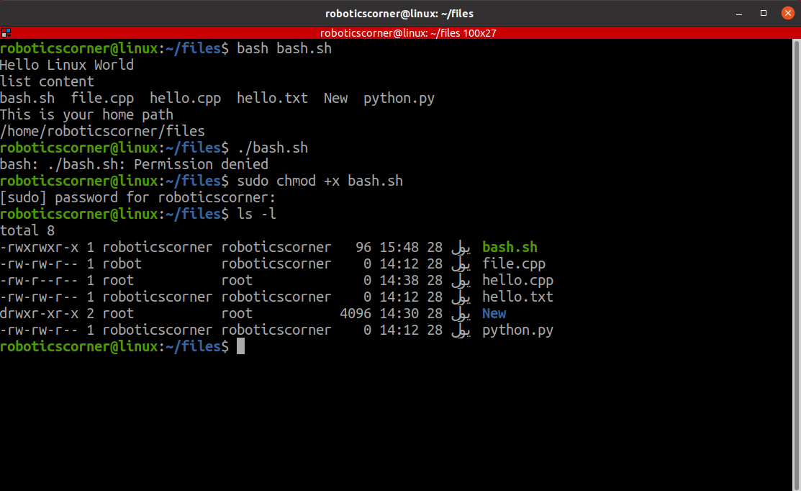
04
Basic shell scripting concepts
How to run the bash file
There is 2 ways
But! That’s not actually how we run it.
We have to make it executable
01285960031
01285960031
www.roboticscorner.tech

Slide 33
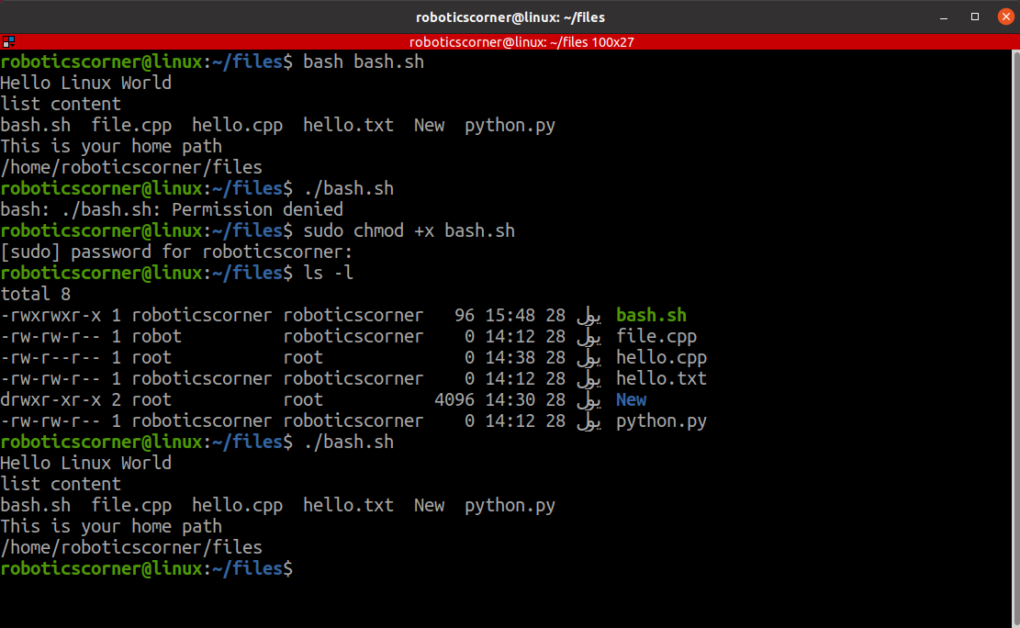
04
Basic shell scripting concepts
How to run the bash file
There is 2 ways
But! That’s not actually how we run it.
We have to make it executable
01285960031
01285960031
www.roboticscorner.tech

Slide 34
Interactive vs noninteractive shell
04
Basic shell scripting concepts
An interactive shell refers to a command-line interface that allows users to interact with the computer's operating system by typing commands in real-time and receiving immediate feedback. In an interactive shell, users can enter commands, execute programs, and perform various tasks by typing text-based commands.
A non-interactive shell is a shell session that runs without direct interaction with a user through a command-line interface. In a non-interactive shell, commands are often executed from scripts or other automated processes, and there is typically no user input or interaction during the execution. A shell running a script is always a non-interactive shell.
01285960031
01285960031
www.roboticscorner.tech

Slide 35
subshell
04
Basic shell scripting concepts
A subshell is a child shell that is spawned by the main shell (also known as the parent shell). It is a separate process with its own set of variables and command history, and it allows you to execute commands and perform operations within a separate environment.
01285960031
01285960031
www.roboticscorner.tech

Slide 36
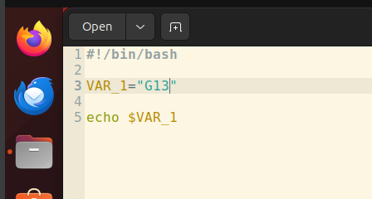
Variables in shell scripting
04
Basic shell scripting concepts
A symbolic name for a chunk of memory to which we can assign values, read and manipulate its contents.
01285960031
01285960031
www.roboticscorner.tech

Slide 37
Variables
04
Basic shell scripting concepts
Must start with a letter or underscore
Number can be used anywhere else
Do not use special characters such as @,#,%,$
Case sensitive
Allowed: VARIABLE, VAR1234able, var_name, _VAR
Not allowed: 1var, %name, $myvar, var@NAME, myvar-1
To reference a variable, prepend $ to the name of the variable
Example: $PATH, $LD_LIBRARY_PATH, $myvar etc.
01285960031
01285960031
www.roboticscorner.tech

Slide 38
Local and global variables
04
Basic shell scripting concepts
Variables created and used inside a shell are only local to the shell and can’t be seen outside this shell.
If a variable is created in the terminal and used in a process for example, this variable is local to this terminal and can’t be seen elsewhere.
Global variables are variables that are accessible and can be modified throughout the entire script, regardless of their initial declaration.
Like: PATH, LD_LIBRARY_PATH, DISPLAY
cmake –version: export name=value(directory)
01285960031
01285960031
www.roboticscorner.tech

Slide 39
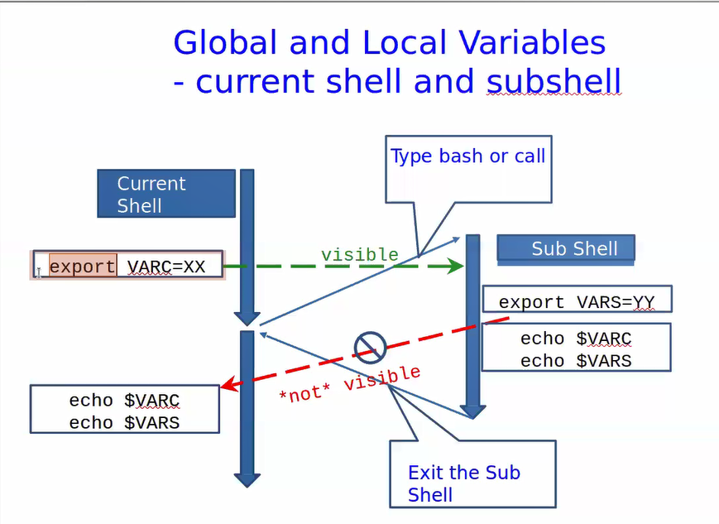
04
Basic shell scripting concepts
01285960031
01285960031
www.roboticscorner.tech

Slide 40
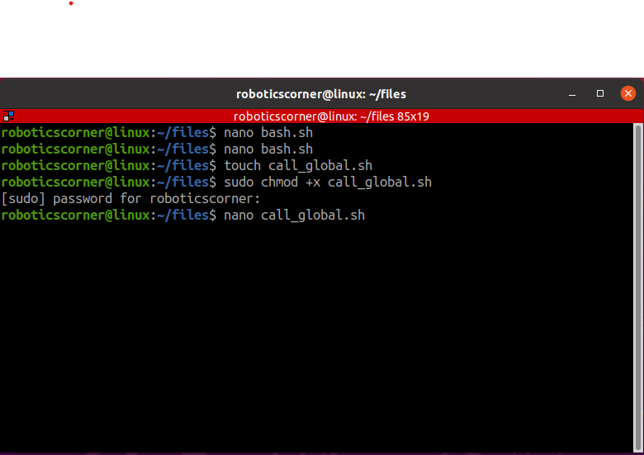
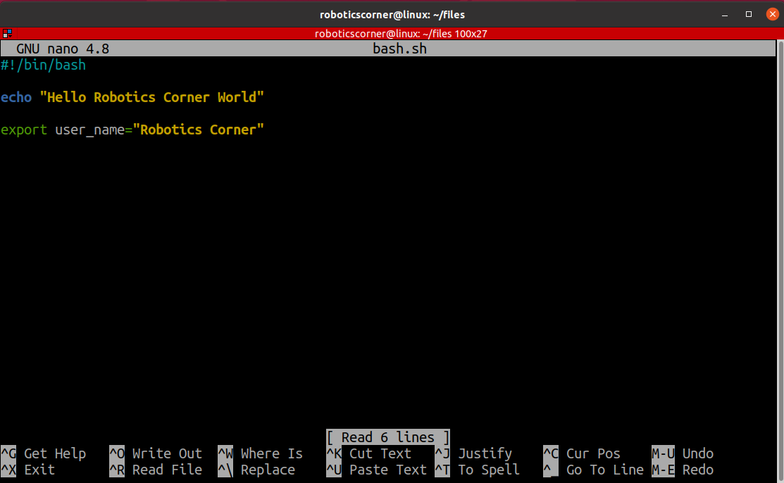
04
Basic shell scripting concepts
01285960031
01285960031
www.roboticscorner.tech

Slide 41
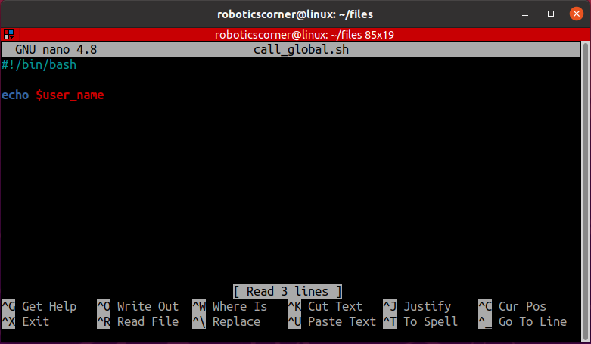
04
Basic shell scripting concepts
01285960031
01285960031
www.roboticscorner.tech

Slide 42
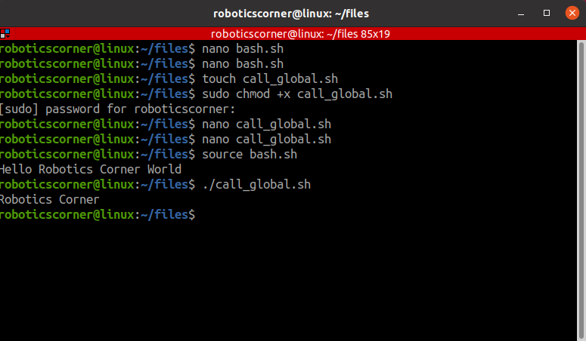
04
Basic shell scripting concepts
01285960031
01285960031
www.roboticscorner.tech

Slide 43
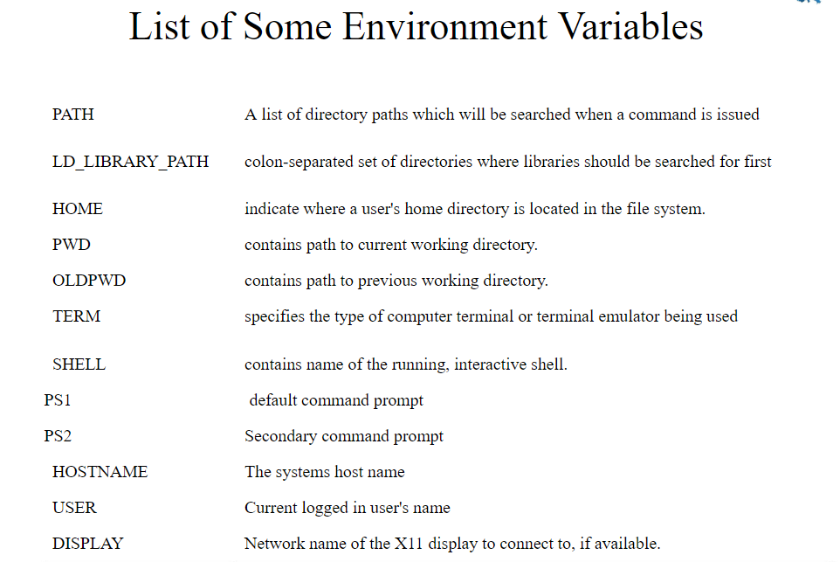
04
Basic shell scripting concepts
01285960031
01285960031
www.roboticscorner.tech

Slide 44
quotations
04
Basic shell scripting concepts
Single quotation: Enclosing characters in single quotes (') preserves the literal value of each character within the quotes. A single quote may not occur between single quotes, even when preceded by a backslash.
Double quotation: Enclosing characters in double quotes (") preserves the literal value of all characters within the quotes, with the exception of ‘$’, ‘`’, ‘\’
01285960031
01285960031
www.roboticscorner.tech

Slide 45
quotation
04
Basic shell scripting concepts
Str1=‘echo $USER’
Echo “$str1” → echo $USER
Str2=“echo $USER”
Echo “$str2” → echo YOUR_USERNAME
Str3=`echo $USER`
Echo $str3 → YOUR_USERNAME
Str4=$(echo $USER)
Echo “$str4” →YOUR_USERNAME
01285960031
01285960031
www.roboticscorner.tech

Slide 46
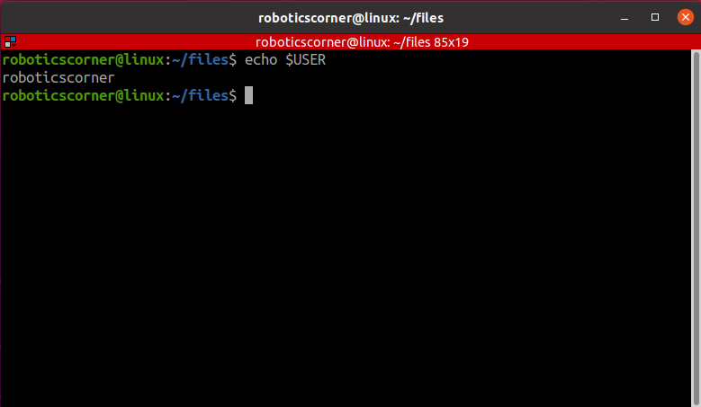
04
Basic shell scripting concepts
01285960031
01285960031
www.roboticscorner.tech

Slide 47
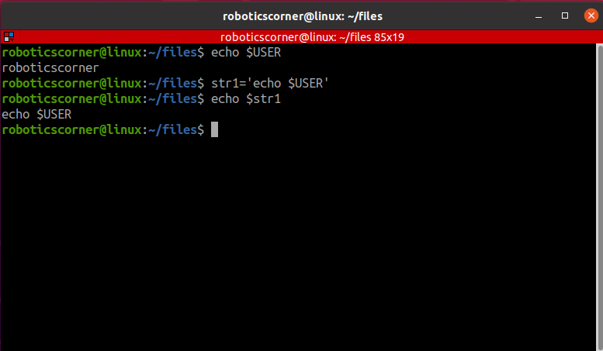
04
Basic shell scripting concepts
01285960031
01285960031
www.roboticscorner.tech

Slide 48
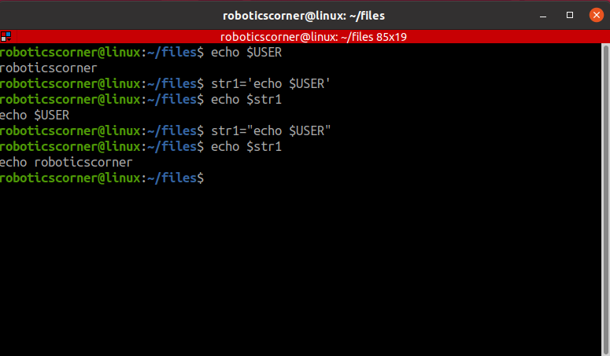
04
Basic shell scripting concepts
01285960031
01285960031
www.roboticscorner.tech

Slide 49
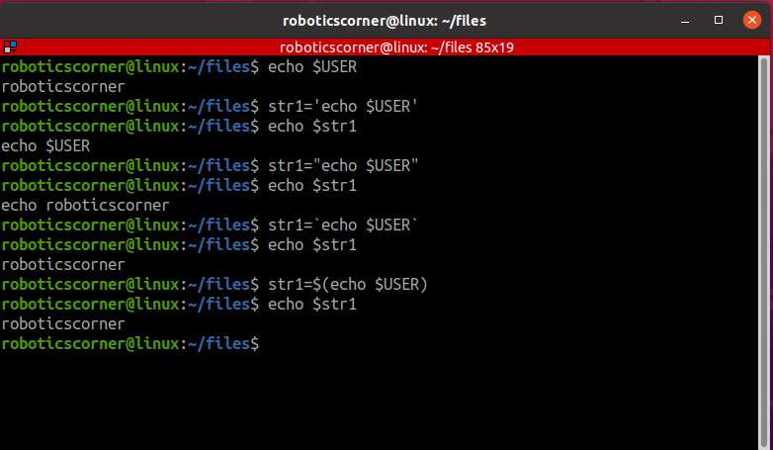
04
Basic shell scripting concepts
01285960031
01285960031
www.roboticscorner.tech

Slide 50
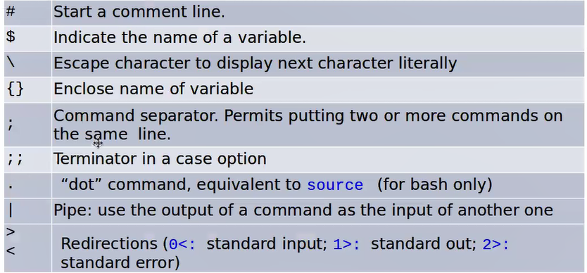
Special characters
04
Basic shell scripting concepts
01285960031
01285960031
www.roboticscorner.tech

Slide 51
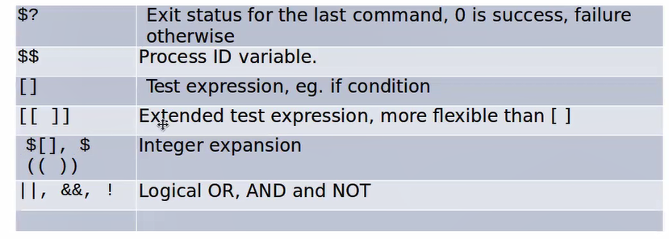
04
Basic shell scripting concepts
01285960031
01285960031
www.roboticscorner.tech

Slide 52
Integer Arithmetic Operations
04
Basic shell scripting concepts
$((expression))
$(( n1+n2 ))
$(( n1/n2 ))
$(( n1-n2 ))
Addition, Subtraction, Multiplication, Division, Exponentiation, Modulus
01285960031
01285960031
www.roboticscorner.tech

Slide 53
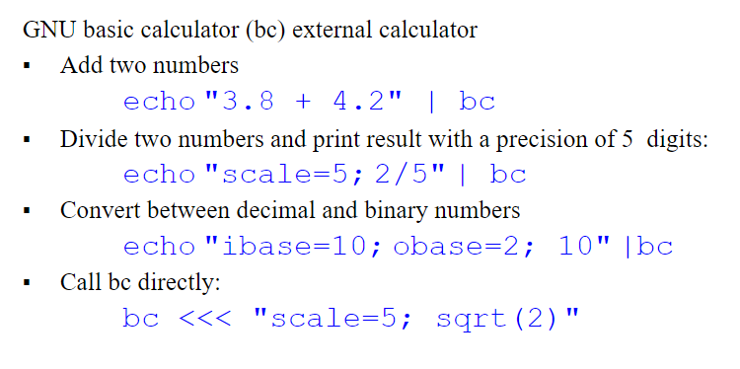
Floating-Point Arithmetic Operations
04
Basic shell scripting concepts
01285960031
01285960031
www.roboticscorner.tech

Slide 54
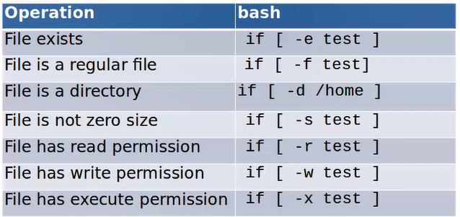
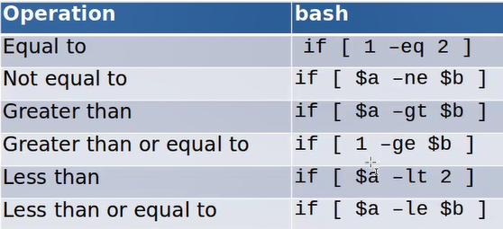
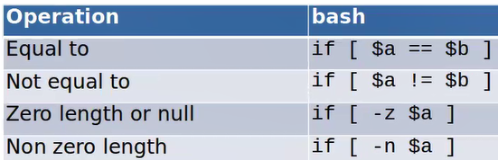
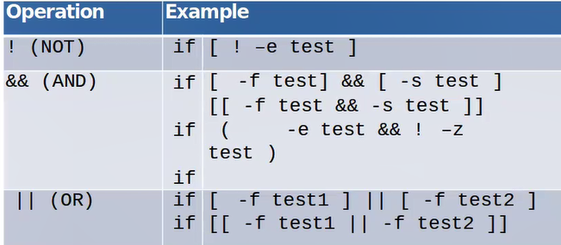
04
Basic shell scripting concepts
01285960031
01285960031
www.roboticscorner.tech

Slide 55
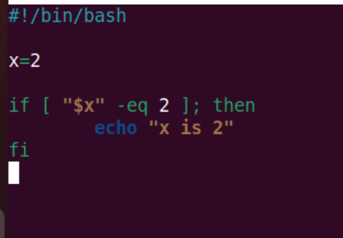
Conditional statements
04
Basic shell scripting concepts
01285960031
01285960031
www.roboticscorner.tech

Slide 56
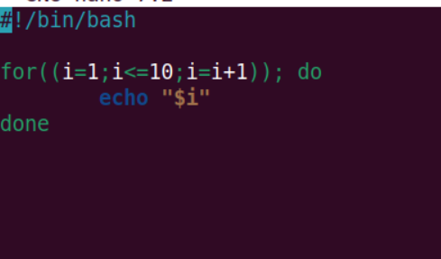
Loops
04
Basic shell scripting concepts
A loop is a block of code that iterates a list of commands as long as the loop control condition stays true
Loop constructs
for, while and until
01285960031
01285960031
www.roboticscorner.tech

Slide 57
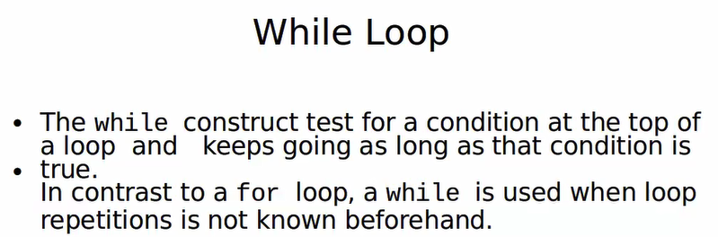
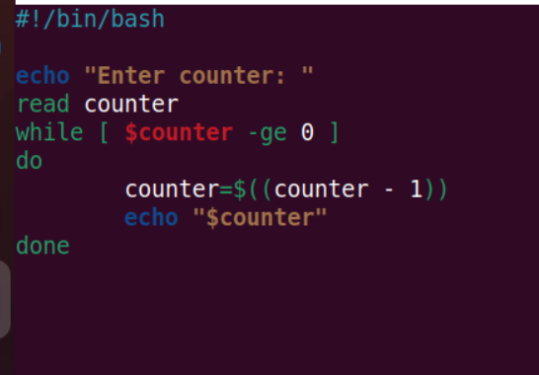
04
Basic shell scripting concepts
01285960031
01285960031
www.roboticscorner.tech

Slide 58
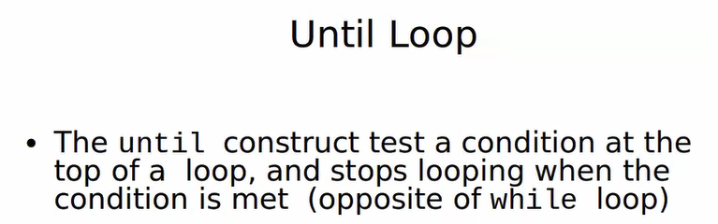

04
Basic shell scripting concepts
01285960031
01285960031
www.roboticscorner.tech

Slide 59
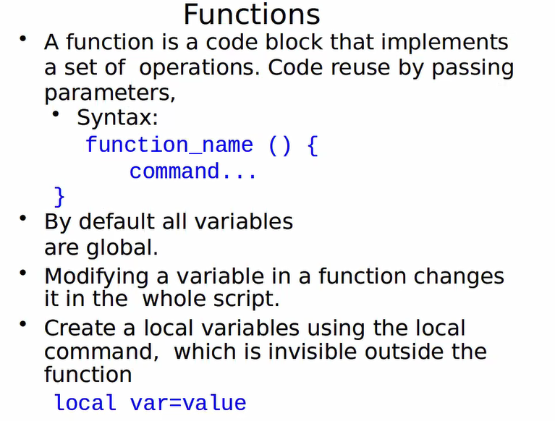
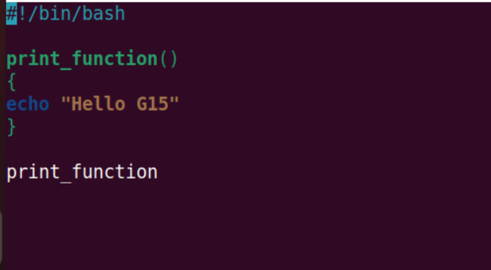
04
Basic shell scripting concepts
01285960031
01285960031
www.roboticscorner.tech

Slide 60
functions
04
Basic shell scripting concepts
#!/bin/bash
# Basic function
print_something () {
echo Hello I am a function
}
print_something
print_something
01285960031
01285960031
www.roboticscorner.tech

Slide 61
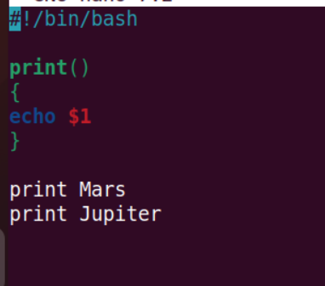
Passing Arguments
04
Basic shell scripting concepts
Within the function they are accessible as $1, $2, etc.
#!/bin/bash
# Passing arguments to a function
print_something () {
echo Hello $1
}
print_something Mars
print_something Jupiter
01285960031
01285960031
www.roboticscorner.tech

Slide 62
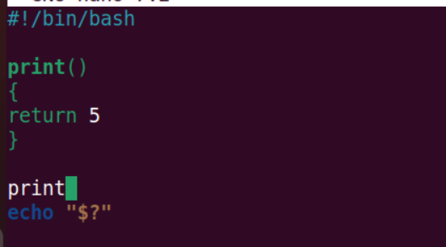
Return Values
04
Basic shell scripting concepts
#!/bin/bash
# Setting a return status for a function
print_something () {
echo Hello $1
return 5
}
print_something Mars
print_something Jupiter
echo The previous function has a return value of $?
01285960031
01285960031
www.roboticscorner.tech

Slide 63
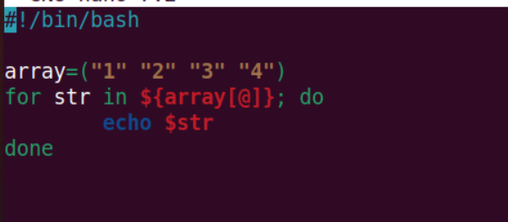
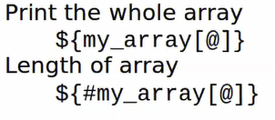
arrays
04
Basic shell scripting concepts
myArray=("cat" "dog" "mouse" "frog")
  for str in ${myArray[@]}; do
  echo $str
  done
01285960031
01285960031
www.roboticscorner.tech

Slide 64
TASK1
04
Basic shell scripting concepts
Implement a function that takes 2 inputs and performs
1. addition of the 2 numbers
2. Print the result
3. loops over the resulting addition and decrementing the value printing the result inside the loop
01285960031
01285960031
www.roboticscorner.tech

Slide 65
Assignment
04
Basic shell scripting concepts
Create a directory called dip that has 5 files: f1 f2 f3 f4 f5
Implement a bash script that lists all the files in this directory and deletes the directory with its content using a LOOP
01285960031
01285960031
www.roboticscorner.tech

Slide 66
POSIX
04
Basic shell scripting concepts
A POSIX (Portable Operating System Interface) system refers to an operating system that adheres to a set of standards specified by the IEEE (Institute of Electrical and Electronics Engineers) in the POSIX family of standards. The POSIX standards define a set of APIs (Application Programming Interfaces) and other conventions for ensuring compatibility between different Unix-like operating systems.
Shell and Utilities, File System Structure, Process Control, User and Group IDs, IO Operations, Networking, threads, and system adminstration
01285960031
01285960031
www.roboticscorner.tech

Slide 67


Slide 68

01211626904
www.roboticscorner.tech
Robotics Corner
Robotics Corner
Robotics Corner
Robotics Corner

